Slide 1

dev team
Alberto Ponce
Ryan Karcaw
Armine Arutyunyan
Maura Ellsworth

Slide 2

IAH
george bush intercontinental houston airport

Slide 3

Our problem: flight delays
Flight delays cause:
Missed connections
Loss of vacation days
Unexpected costs such as needing to purchase a new hotel or flight
In 2022 there we accounted for 1,557,771 minutes of delay at IAH…
that’s 3 YEARS

Slide 4

Our project
We discovered that there is no great way to figure out how likely your airline is goingto be delayed. So we developed a platform that shows statistical information on how likely your flight will be delayed based on airlines.

Slide 5

Given that most minutes of delay come from arrival delay, ie. delays caused by causes external to the IAH terminal.

Slide 6

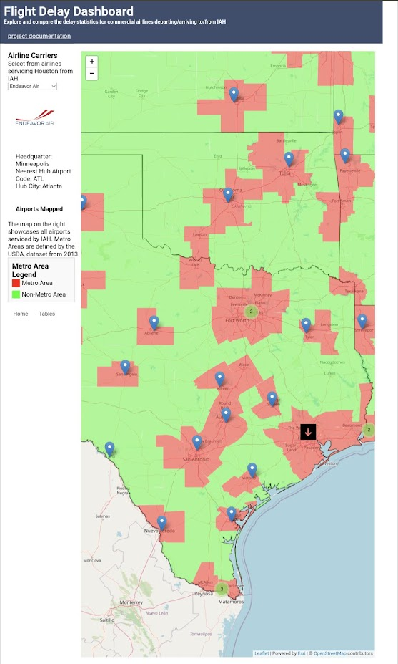
Our product serves as a exploratory, informational tool that provides customers a high-level summary of how their origin/destination might affect the amount of delay.

Slide 7

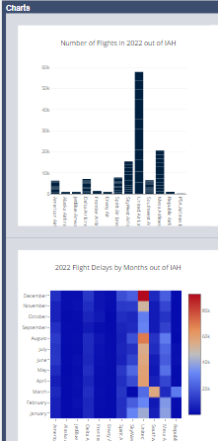
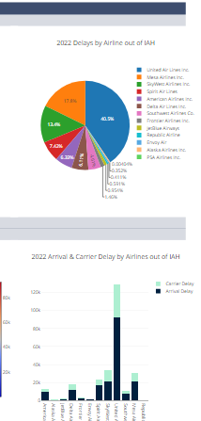
CHARTS
Our application offers multiple types of high-level analysis for direct user consumption.

Slide 8

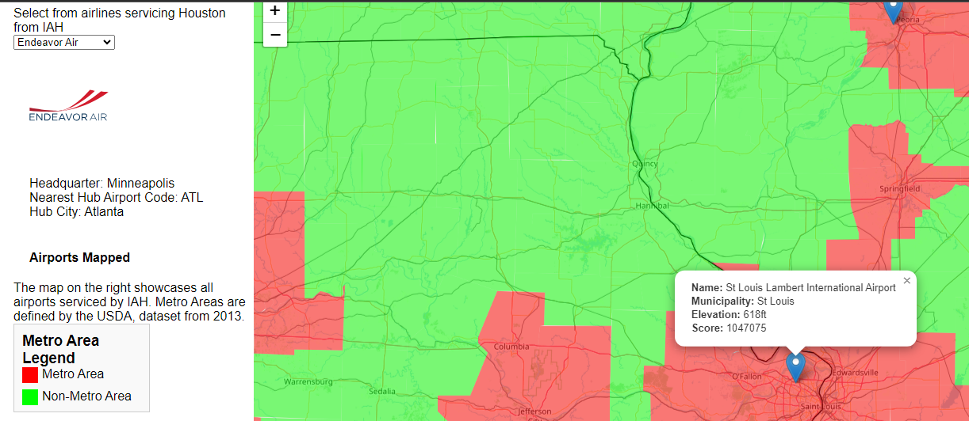
MAPPING
Given any airline, the user can find information about the airline’s hub, headquarters, and information about the airport of origin/destination.

Slide 9


Technology Stack

Slide 10

documentation
Journal-type entries that document our journey in developing this full-stack application using markdown.
https://memellsworth.github.io/Project3/journal/project-development-journal-entries.html

Slide 11
Thank you!

